Slide 1
Rules for Creating some great HTML code

Slide 2
5 Rules
1. Tags are always surrounded by angle brackets (less-than/greater-than characters),
<HEAD>.

Slide 3

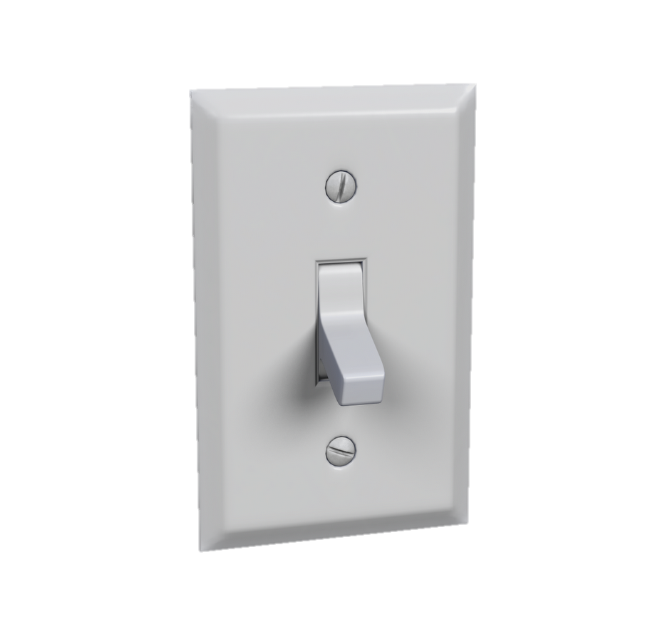
Most tags come in pairs and surround the material they affect.
They work like a light switch:
the first tag turns the action on,
and the second turns it off.
The second tag--the "off switch"--always starts with a forward slash. For example, you turn on bold with <b>, shout your piece, and then go back to regular text with </b>.
There are some exceptions. <br/> <hr/> <img/>. These are called void tags in HTML 5.
GOOD
<b> It’s a great day! </b>
BAD
<b> It’s a great day.

Slide 4
Order Matters
First tag on, last tag off.
Tags are embedded, so when you start a tag within another tag, close that inner tag before closing the outer tag.
GOOD
<h1> Hello there! </h1> <p> Everyone in the world. </p>
BAD
<h1> Hello there! <p> Everyone in the world. </h1> </p>

Slide 5

Use Lowercase letters
GOOD:
<a href="https://www.w3schools.com/html/">
Visit our HTML tutorial</a>
BAD:
<A HREF="https://www.w3schools.com/html/">
Visit our HTML tutorial</a>
HTML allows mixing uppercase and lowercase letters in attribute names.
However, we recommend using lowercase attribute names, because:
Mixing uppercase and lowercase names looks bad
Developers normally use lowercase names
Lowercase look cleaner
Lowercase are easier to write

Slide 6
Use spacing logically-
Do not add blank lines, spaces, or indentations without a reason.
For readability, add blank lines to separate large or logical code blocks.
https://www.w3schools.com/html/tryit.asp?filename=tryhtml_poem

